Slide 1


DEPARTMENT OF COMPUTER SCIENCE & ENGINEERING
Subject Name: Multimedia Technologies
Subject Code: (20CST-334/20ITT-334)
Lecture 20
Topics Covered: Dynamic range correction, Gamma
correction, Photo Retouching
DISCOVER . LEARN . EMPOWER

Slide 2
Gamma correction
How to Adjust Gamma in Photoshop
Gamma correction is a technique in Adobe Photoshop CS6 and CC that enables you to adjust how an image is displayed on your monitor. Incorrect gamma settings can make images look too dark or washed out. This does not mean that the gamma setting is the same as the brightness setting, though, as it only adjusts the dark tones. In Photoshop, you can either adjust the gamma of an image directly or via an adjustment layer; the latter method preserves the information on the original layer.

Slide 3
Gamma correction
Step 1
Open Adobe Photoshop, and then open the image for which you want to adjust the gamma levels.
Step 2
Select "Image" from the menu bar, choose "Adjustments" from the options list, and then select "Exposure." Alternatively, select "Layers" from the menu bar, choose "New Adjustment Layer" from the options list, and then select "Exposure." Click "OK" if you opted for the latter method to create the adjustment layer.

Slide 4
Gamma correction
Step 3
Click and drag the Gamma Correction slider to the left to increase the gamma levels or to the right to decrease. Keep an eye on the images to see the changes in real-time. When using an adjustment layer, the gamma slider is not on a pop-up window, but on the Properties tab.
Step 4
Click "OK" when you are satisfied with the gamma levels of the image. When using an adjustment layer, the changes are applied automatically and there is no "OK" button.

Slide 5
Photo Retouching
Every photo may not look perfect after a photoshoot. If you want to get quality output, you must go for photo editing or retouching. Photo Retouching is a post-production photo editing service where a retoucher makes the photo clean & polish and removes the unexpected things from the image.
No one expects unwanted things or disturbing elements into their photos. But sometimes, those issues come when capturing. So, it requires retouching that photo and making that photo awesome as per the clients’ expectations.

Slide 6
Difference between Editing and Retouching
Sometimes many of us think photo editing and retouching are the same. But there are some differences between those two terms.
Editing: Editors have to edit almost every photo. Correction of primary colors, temperature, crop an image, doing blur, adding signature, etc., are the works of editing. Those are simple and less time-consuming tasks.

Slide 7
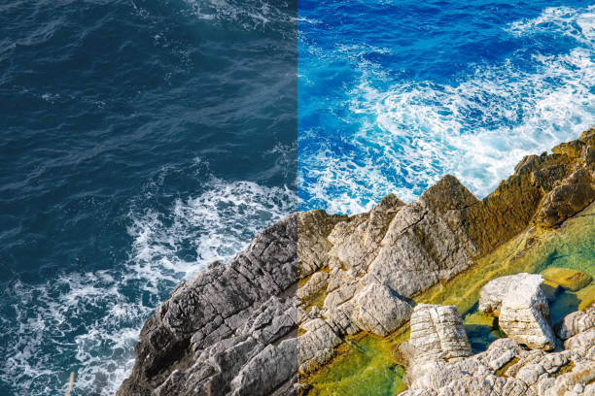
Difference between Editing and Retouching

Slide 8
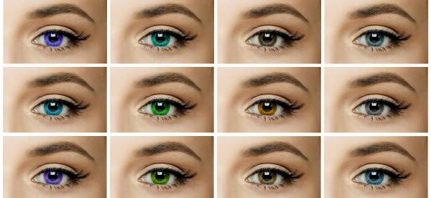
Difference between Editing and Retouching
Retouching: Retouching is the in-depth process of image editing. Here the editor/retoucher has to do a lot of things to get a quality output. For example, teeth whitening, remove unwanted objects or items, remove background, remove undesirable persons, merge two photos, etc. This process is time-consuming and a little bit complex.

Slide 9
Difference between Editing and Retouching
Types of retouching
Retouching is an excellent way to give a professional look in a photo. It makes a photo clean, clear, fresh, and gorgeous. There are different types of retouching services.
High-end retouching:
This type of retouching helps to remove unwanted spots, wrinkles, and any kinds of disturbing things from the face. It gives a better output of a model photo. If you want to use your images on e-commerce sites or billboards, you need to use this service.

Slide 10

Difference between Editing and Retouching

Slide 11
Any query ??

Slide 12
Thank you

